Slide 1
PROJECT TITLE:
Full Name : Aditya Singh
Registered Mail ID : adityasingh.pbt@gmail.com
College Name : SRM Institute of Science and Technology, NCR-Campus, Ghaziabad
Mob No. 8279453158 IBM SkillsBuild platform mail ID : adityasingh.pbt@gmail.com

Slide 2
PROJECT TITLE:
Full Name : Krish Sachan
Registered Mail ID :krishsachan21@gmail.com
College Name : SRM Institute of Science and Technology, NCR-Campus, Ghaziabad
Mob No. 8318549979 IBM SkillsBuild platform mail ID : krishsachan21@gmail.com

Slide 3
PROJECT TITLE:
Full Name : Ayushmaan Singh
Registered Mail ID :ayushmaan02803@gmail.com
College Name : SRM Institute of Science and Technology, NCR-Campus, Ghaziabad
Mob No. 9798406789 IBM SkillsBuild platform mail ID :ayushmaan02803@gmail.com

Slide 4

AQUAGUARD AI
Water pollution doesn't wait for
the next lab report.
An always-on monitoring agent that reads live water-quality data, tells authorities exactly what's wrong, and does it within minutes of a breach.
Investor & Partner Briefing · AquaGuard AI Founding Team · 2026

Slide 5
AGENDA
What we'll cover.
01
The Problem Why pollution detection is too slow today
02
Impact The impact on aquatic life
03
Consequences What is the cost of delay
04
Market Opportunity The size and shape of the demand
05
Our Solution What AquaGuard AI does differently
06
How it Works detection-to-alert pipeline
07
Product Snapshot What an authority actually receives
08
Competitive Landscape where we sit verses alternatives
09
Customers & Early Adopters Who we serve first
10
Business Model The How AquaGuard AI makes money
11
Why Aquaguard Our advantage and key metrics
12
Roadmap The path from pilot to scale
13
The Ask How we would like to work together
AQUAGUARD AI
02

Slide 6



THE PROBLEM
Contamination is found late — after it's already spread.
Detection lags reality
Testing is manual & rare
Response is reactive
Industrial discharge, runoff, and sewage leaks often go unnoticed for hours or days before anyone checks the water.
Lab sampling needs trained staff and equipment, so most sites are only checked weekly — or less.
Agencies typically hear about a problem only after fish kills, odor complaints, or visible damage appear.
Existing alternatives: manual lab sampling · static IoT dashboards nobody watches live · waiting for public complaints
AQUAGUARD AI
03

Slide 7
IMPACT
Impact on Aquatic Life
1
Q2
2
Q3
3
Q4
Oxygen Starvation
Gill Clogging
Acidification & ph
Runoff and waste elevate turbidity past 50 NTU. Suspended sediment physically scrapes respiratory membranes and blocks essential sunlight for underwater plants..
Undetected organic spikes plunge dissolved oxygen below critical thresholds (< 4 mg/L). Fish suffer acute gill stress, triggering mass suffocation events within hours.
Chemical dumps create rapid pH shifts. Severe drops below 5.5 strip protective mucus coatings from fish skins, destroy egg clusters, and dissolve mollusk shells.
AQUAGUARD AI
04

Slide 8



CONSEQUENCES
Cost of delay could be catastrophic.
The exponential growth of ecological damage and financial liabilities over time..
01
02
03
04
Hour 0-4
Hour 4-12
Hour 12-48
Day 3+
Silent Dispersion
Toxins disperse rapidly downstream. Plume expands without visual signs. Alerts remain silent.
Acute Stress
Sensitive benthic organisms die off. Fish suffer elevated respiratory rates and gill tissue damage.
Systemic Crash
Widespread fish mortality. Strong odors trigger community reports. Water closures mandated.
Heavy Liabilities
Toxins settle in riverbeds. Cleanup costs reach millions. Heavy fines and lawsuits are initiated.
AQUAGUARD AI
05

Slide 9

MARKET OPPORTUNITY
A market already moving toward real-time monitoring.
~$6.3B
~$11B
~7.6%
40%+
Global water-quality monitoring market, 2026
Projected market size by 2034
Compound annual growth rate
Share now going to real-time/online systems
Source: industry market-research estimates (2026 reports), rounded for presentation.
Why now
Tightening regulation (Clean Water Act, EPA PFAS rules) is pushing utilities from periodic sampling to continuous monitoring.
Sensor and IoT hardware costs keep falling, so more sites can afford always-on data feeds.
Generative AI now makes it practical to turn raw sensor data into a written, actionable report — without a human analyst on call 24/7.
AQUAGUARD AI
06

Slide 10




OUR SOLUTION
An AI monitoring agent that never clocks out.
Built around three moves
Continuous, not periodic
Hourly automated pH, turbidity, and dissolved-oxygen readings replace weekly manual checks.
Unique Value Proposition
Turns raw sensor readings into an AI-written pollution report and authority alert — in minutes, not days.
Judgment, not just data
A domain-tuned AI agent explains severity, ecological impact, and what to do next.
HIGH-LEVEL CONCEPT
Action, not a dashboard
“A smoke alarm for waterways.”
Authorities are emailed and the incident is logged the moment a threshold is breached.
AQUAGUARD AI
07

Slide 11


HOW IT WORKS
From sensor reading to authority alert — fully automated.
01
02
03
04
Monitor hourly
Classify instantly
AI assessment
Alert & log
Pulls fresh pH, turbidity & dissolved-oxygen readings every hour.
Flags any reading that breaches safe thresholds.
A marine-scientist AI agent writes severity, impact & remediation steps.
Emails authorities and records the incident automatically.
Every run is idempotent: readings already processed are never re-alerted or re-logged.
AQUAGUARD AI
08

Slide 12
PRODUCT SNAPSHOT
What the authority actually receives.
LIVE READING — Site 14, Delta Estuary
AI Pollution Assessment
pH
5.4
Generated in ~8 seconds by the Marine Environmental Scientist agent
below safe (< 6)
Turbidity
68 NTU
Pollution Assessment
above safe (> 50)
Three parameters breached simultaneously — moderate-to-severe acute event, consistent with a runoff or discharge spike.
Dissolved O₂
4.1 mg/L
below safe (< 5)
Impact on Aquatic Life
STATUS
Low oxygen and high turbidity stress gill function in fish and invertebrates; low pH risks shell and egg viability.
POLLUTED
Recommended Actions
Dispatch a field team within 4 hours, trace the upstream source, and re-sample hourly until readings normalize.
AQUAGUARD AI
09

Slide 13


COMPETITIVE LANDSCAPE
Everyone measures water. Almost no one acts on it in real time.
Capability
Manual Lab
Testing
Static IoT
Dashboards
AquaGuard AI
Continuous hourly readings
Automatic pollution classification
Written scientific impact assessment
Instant authority alerting
Auto-logged, auditable incident trail
No dedicated analyst required
AQUAGUARD AI
10

Slide 14



MARKET & CUSTOMERS
Who's responsible for water quality — and who feels it first.
Customer Segments
Municipal water authorities
Early Adopters
Water districts with sensors already installed, but no automated alerting layer on top
Environmental protection agencies
Industrial wastewater dischargers
River & lake conservation NGOs monitoring specific watersheds
Aquaculture & fisheries operators
Industrial sites under regulatory pressure to self-monitor discharge
AQUAGUARD AI
11

Slide 15


BUSINESS MODEL
Priced like the infrastructure it protects.
Revenue Streams
Cost Structure
Per-site monthly subscription
Sensor & data-feed costs
Tiered pricing by monitoring points
Cloud & automation hosting
AI / LLM API usage per assessment
Incident-response consulting add-on
Customer acquisition
Government monitoring contracts & grants
Engineering & compliance staff
AQUAGUARD AI
12

Slide 16

WHY AQUAGUARD
The pipeline is easy to sketch. It's hard to run end-to-end.
Unfair Advantage
A single automated pipeline pairs a domain-tuned “environmental scientist” AI agent with detection and alerting — plus a growing incident-log dataset that sharpens every future assessment.
Key Metrics We Track
<1 hr
~8 sec
100%
0
Detection cadence
Time to AI assessment
Incidents auto-logged
Missed alerts on breach
AQUAGUARD AI
13

Slide 17
ROADMAP
From one watershed to a standard layer of water infrastructure.
Q1
Q2
Q3
Q4
Pilot
Expand
Certify
Scale
Run AquaGuard AI live on one watershed with a design partner; validate detection accuracy and alert quality against manual sampling.
Onboard 5 sites across 2–3 partners; add more sensor types and tune the AI assessment with real incident feedback.
Pursue compliance & data-handling certifications needed for municipal and government procurement.
Open self-serve onboarding, launch tiered subscription pricing, and target 50+ monitored sites.
AQUAGUARD AI
14

Slide 18


Let's keep the water clean.
We’re presenting the new technology of NexusSpells.
AquaGuard AI
AquaGuard AI · Founding Team · NexusSpells
AQUAGUARD AI
15

Slide 19

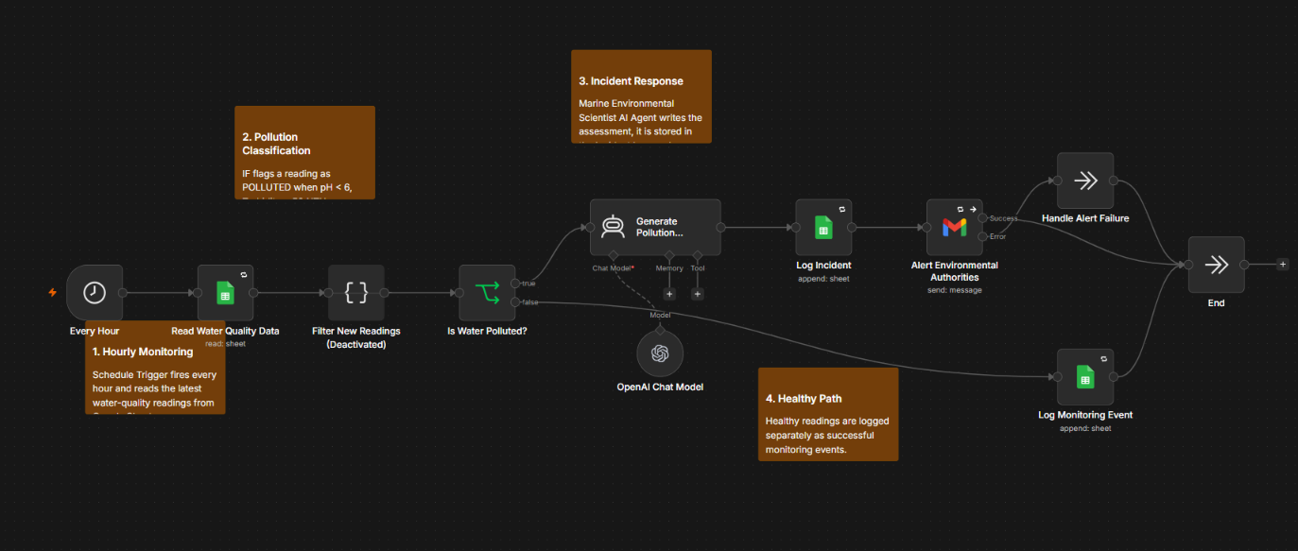
Link to our Model:
https://github.com/Lurking-Demon/AquaGuard-AI-n8n/tree/main
AQUAGUARD AI
16

Slide 20
Thank You
By-
Team NEXUSSPELLS.
AquaGuard AI · Founding Team · NEXUSSPELLS
AQUAGUARD AI
17

